Slide 1
Aboriginal health and disability and the strategic plan
Australian Accessibility Conference
Glenn Pearson
Deputy Director Aboriginal Health
Telethon Kids Institute
February 13th 2020

Slide 2
YIRAH NITCHA WUDJUK
NYUNGAH WIREN BOODJAH
UPON THIS TRADITIONAL AND SACRED LAND
NGULLUK GOORLINY KIDJI
YACKER DANJOO
WE GATHER TO WORK TOGETHER
DJI NGULLAH GOOLANGGASS
GUDJI BULLUP BOORDAH
WAA N
FOR OUR CHILDREN AND THEIR FUTURE

Slide 3
Joining The Dots – Staying Connected - Relationships

Slide 4
Meaning Making – who’s meaning are you making?

Slide 5
Broken and Busted

Slide 6
Child Mortality – Target: Halve the gap in mortality rates for indigenous children under five within a decade (by 2018) – Not met.
in 2018, the indigenous child mortality rate was 141 per 100,000 —twice the rate for non-indigenous children (67 per 100,000)
since the 2008 target baseline, the indigenous child mortality rate has improved slightly, by about 7 per cent. But the mortality rate for non-indigenous children has improved at a faster rate and so the gap has widened.

Slide 7
Early Childhood Education – Target: 95 per cent of all indigenous four-year-olds enrolled in early childhood education (by 2025) – On track.
in 2018, 86.4 per cent of indigenous four-year-olds were enrolled in early childhood education compared with 91.3 per cent of non-Indigenous children
between 2016 and 2018, the proportion of indigenous children enrolled in early childhood education increased by almost 10 percentage points. There was a slight decline of less than one percentage point for non-indigenous children
the attendance rate for indigenous children was highest in inner-regional areas (96.6 per cent), almost 17 percentage points higher than the lowest attendance rate in very remote areas (79.7 per cent).

Slide 8
School Attendance – Target: Close the gap between indigenous and non-indigenous school attendance within five years (by 2018) – Not met.
the majority of indigenous students attended school for an average of just over four days a week in 2019. These students mostly lived in major cities and regional areas
school attendance rates for Indigenous students have not improved over the past five years. Attendance rates for indigenous students remain lower than for non-indigenous students (around 82 per cent compared to 92 per cent in 2019)
gaps in attendance are evident for indigenous children as a group from the first year of schooling, and the gap widens during secondary school. In 2019, the attendance rate for indigenous primary school students was 85 per cent -— a gap of about nine percentage points. By Year 10, indigenous students attend school 72 per cent of the time on average — a gap of about 17 percentage points.

Slide 9
Literacy and Numeracy – Target: Halve the gap for indigenous children in reading, writing and numeracy within a decade (by 2018) – Not met but improvements.
at the national level, the share of indigenous students at or above national minimum standards in reading and numeracy has improved over the decade to 2018. The gap has narrowed across all year levels by between three and 11 percentage points
despite these improvements, in 2018 about one in four Indigenous students in years 5, 7 and 9, and one in five in year 3, remained below national minimum standards in reading. Between 17 to 19 per cent of indigenous students were below the national minimum standards in numeracy
between 2008 and 2018, the share of year 3 students exceeding national minimum standards in reading increased by about 20 percentage points.

Slide 10
Year 12 Attainment – Target: Halve the gap for indigenous Australians aged 20–24 in Year 12 attainment or equivalent attainment rates (by 2020) – On track.
in 2018–19, 66 per cent of indigenous Australians aged 20–24 had attained year 12 or equivalent
between 2008 and 2018–19, the proportion of indigenous Australians aged 20–24 attaining year 12 or equivalent increased by 21 percentage points. The gap has narrowed by 15 percentage points, as non-Indigenous attainment rates have improved at a slower pace
the biggest improvement in year 12 attainment rates was in major cities, where the gap narrowed by 20 percentage points — from 26 percentage points in 2012–13 to six percentage points in 2018–19.

Slide 11
Employment – Target: Halve the gap in employment outcomes between indigenous and non-indigenous Australians within a decade (by 2018) – Not met (stable).
in 2018, the indigenous employment rate was 49 per cent compared to 75 per cent for non-indigenous Australians
over the decade 2008–2018, the employment rate for Indigenous Australians increased slightly (by 0.9 percentage points), while for non-Indigenous Australians it fell by 0.4 percentage points. Thus the gap has not changed much
the indigenous employment rate varied by remoteness. Major cities had the highest employment rate at 59 per cent, compared to 35 per cent in very remote areas. The gap in employment outcomes was widest in remote and very remote Australia.

Slide 12
Life Expectancy – Target: Close the life expectancy gap within a generation (by 2031) – Not on track.
in 2015–2017, life expectancy at birth was 71.6 years for Indigenous males (8.6 years less than non-indigenous males) and 75.6 years for Indigenous females (7.8 years less than non-indigenous females)
over 2006 to 2018, there was an improvement of almost 10 per cent in indigenous age-standardised mortality rates. But non-indigenous mortality rates improved at a similar rate, so the gap has not narrowed
since 2006, there has been an improvement in indigenous mortality rates from circulatory disease (heart disease, stroke and hypertension). But this has coincided with an increase in cancer mortality rates, where the gap is widening.

Slide 13
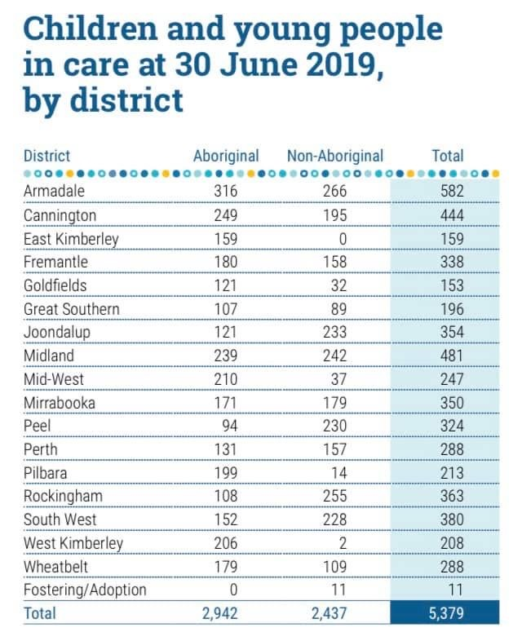

Slide 14
But What If….?

Slide 15
But What If These Were Measures Of Resilience? Measures Of Strength? When the Evidence Says These Measures Should Have Flat Lined Given The Government Policies that Have and Still Pull at the Strength of Aboriginal People, Culture and Families?

Slide 16
Telling the Story Big then Small and Then Big Again

Slide 17
Developing Research Methodologies that Are As Sophisticated as the Worlds and Culture that Our Families Live in

Slide 18
The Non-Negotiable Need for Aboriginal Voice

Slide 19
Swimming the River – Ian Trust (The Wunan Foundation)
https://www.youtube.com/watch?v=0P9FRacTji0&feature=youtu.be

Slide 20
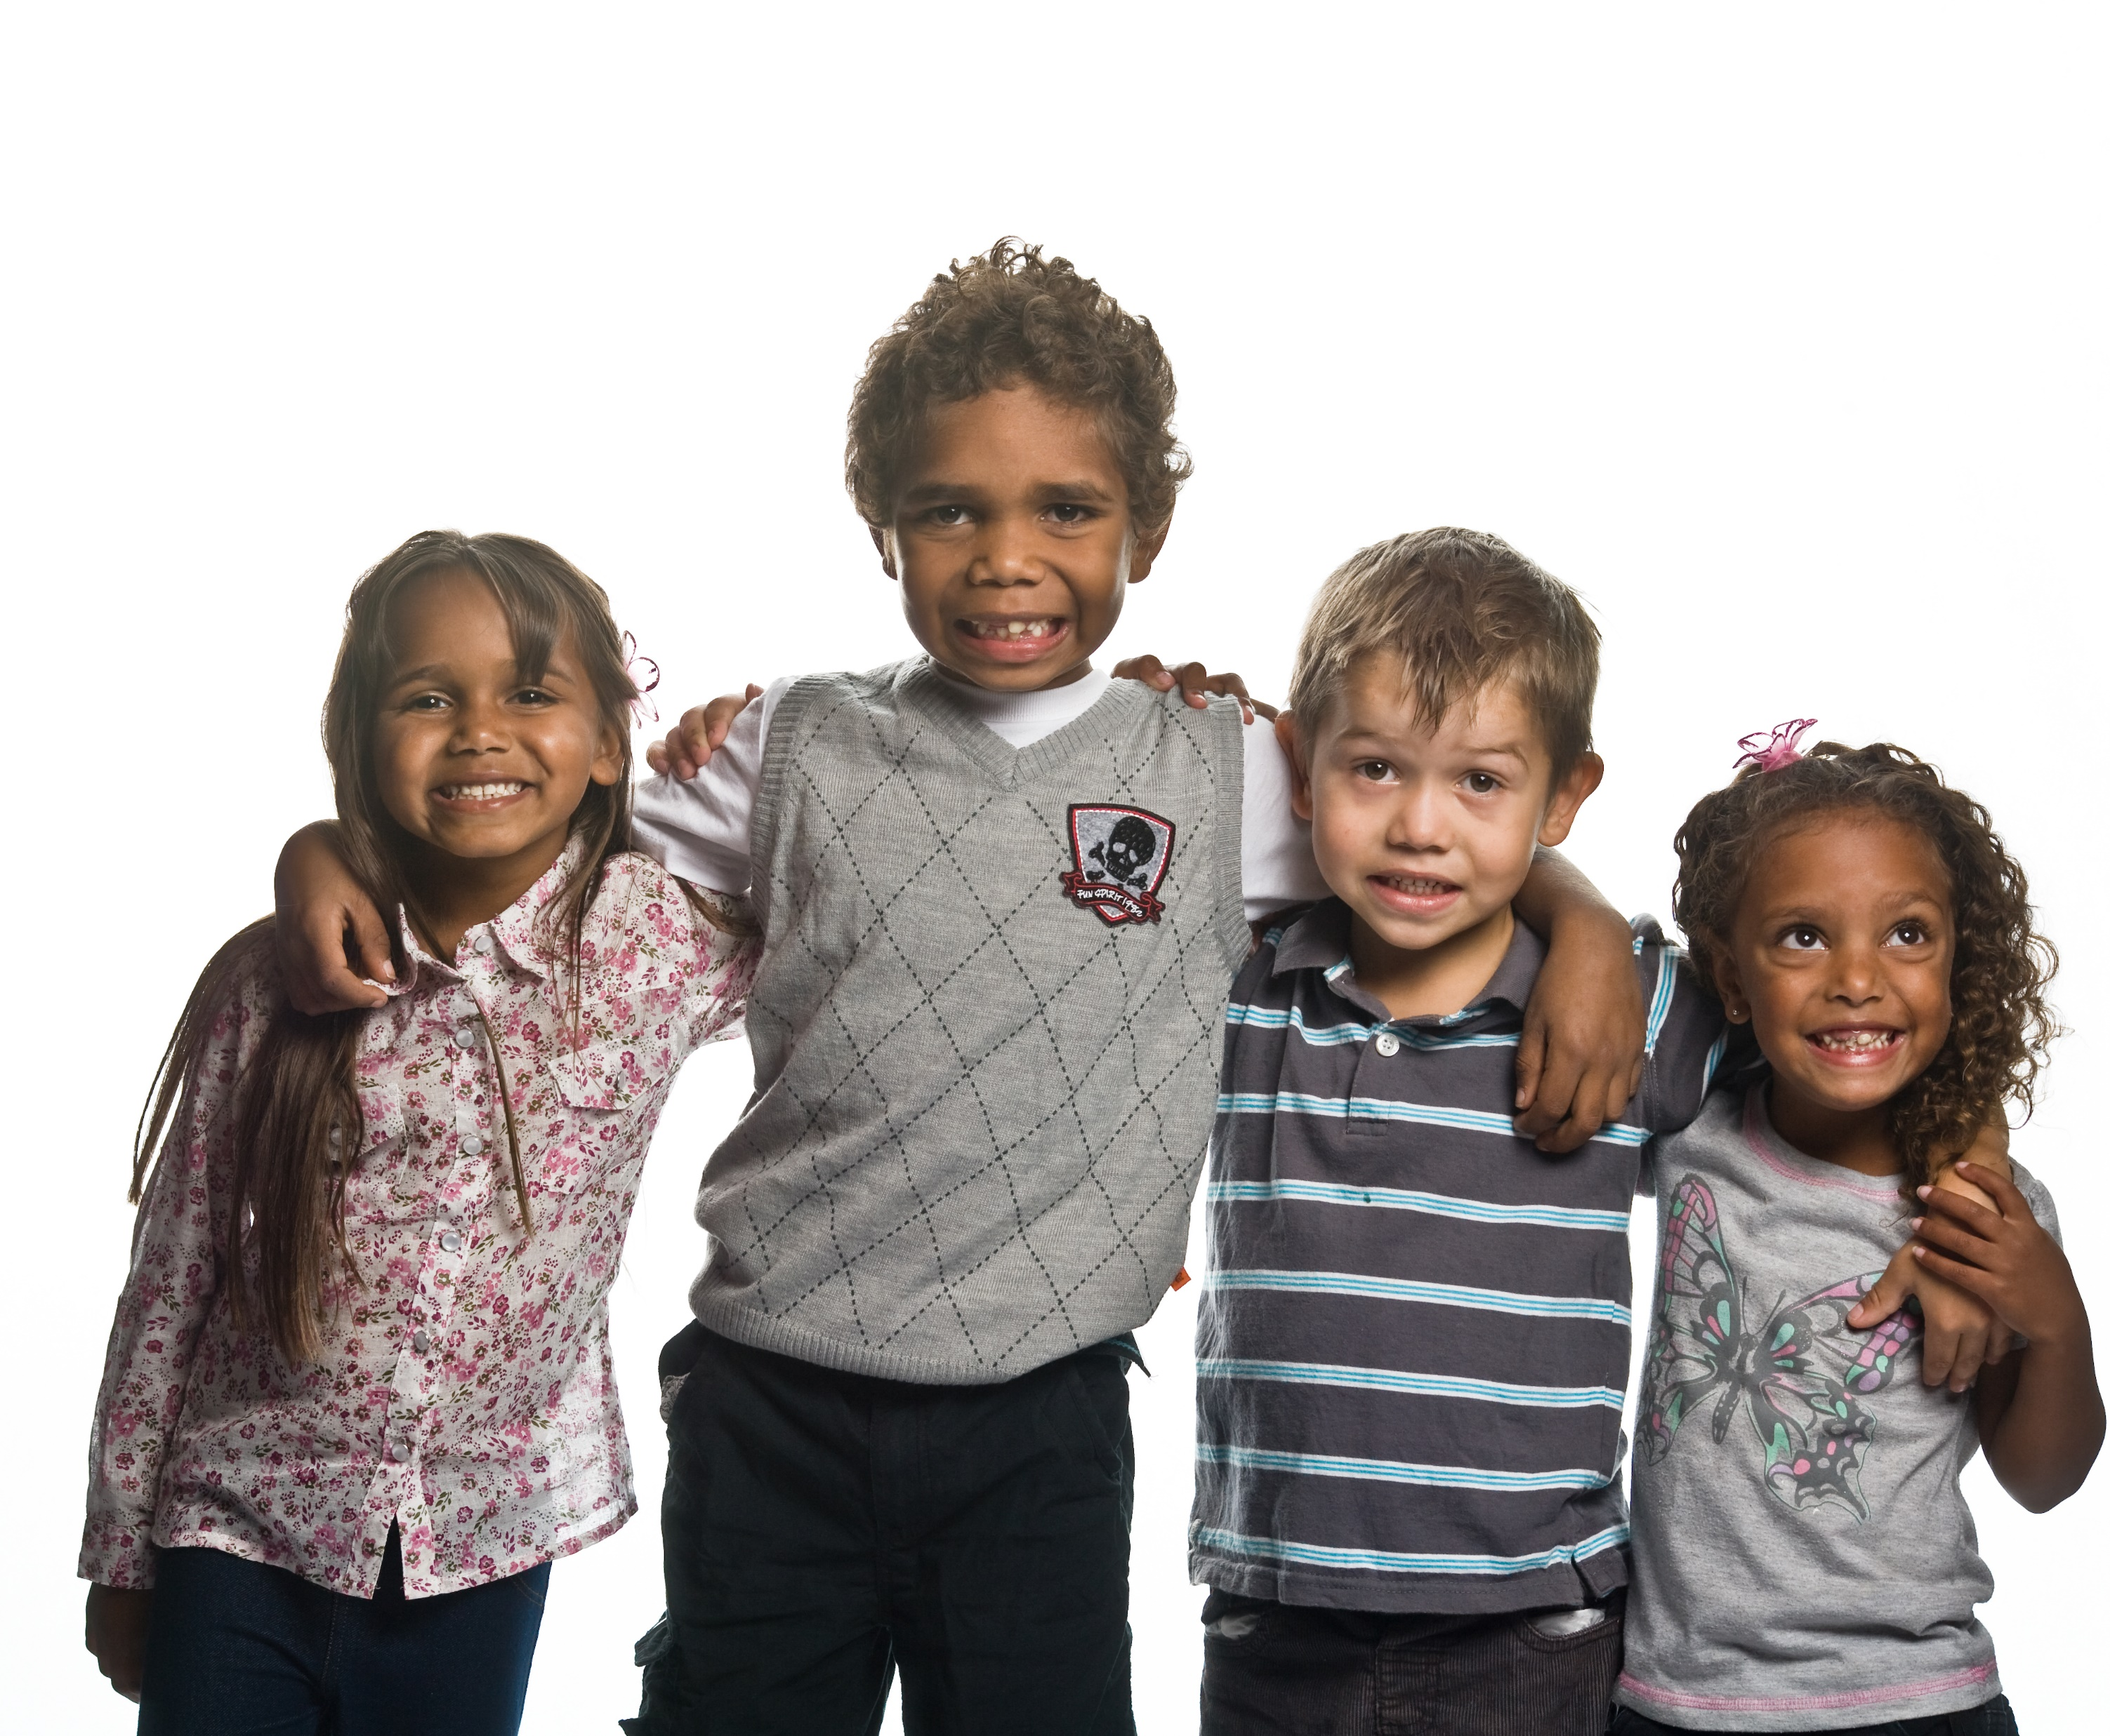
Aboriginal Health 1,000 Families Grand Challenge

Slide 21
Aim and purpose
The 1000 Families Initiative is a world-first scientific program that aims to actively transform the health and hopes of Aboriginal children in Western Australia through an unrelenting focus on supporting families to create and sustain the best possible environments for their children.
With participating families, we will understand the interconnectedness of multiple external and biological factors in the context of child health and social and emotional wellbeing.
We will co-create, deploy and evaluate a culturally aligned and scientifically inspired approach for raising children who thrive in the first five years of life, even when faced with profoundly difficult and disadvantaged circumstances.
This initiative is expected to generate new knowledge for Aboriginal families to overcome disadvantage and improve life trajectories for their children, and provide clear advice to policy makers, governments and funders on what works to support the wellbeing of our most precious resource – the next generation.
This knowledge will be generalised to other families across Western Australia and more broadly. It is an unprecedented initiative in terms of scale, complexity and intensity, and in its life-long outcomes.

Slide 22
Vision for Aboriginal and Torres Strait Islander Health and Wellbeing
That the health and wellbeing of Aboriginal and Torres Strait Islander children is the same as other Australian children

Slide 23
Our Ultimate Key Performance Indicator
How does our research positively change the health and wellbeing of an Aboriginal and Torres Strait Islander child living anywhere in the State from one week to the next?

Slide 24
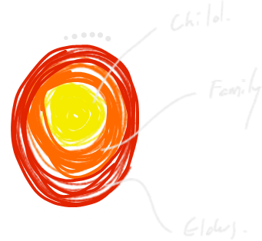
Aboriginal Health Grand Challenge

Slide 26
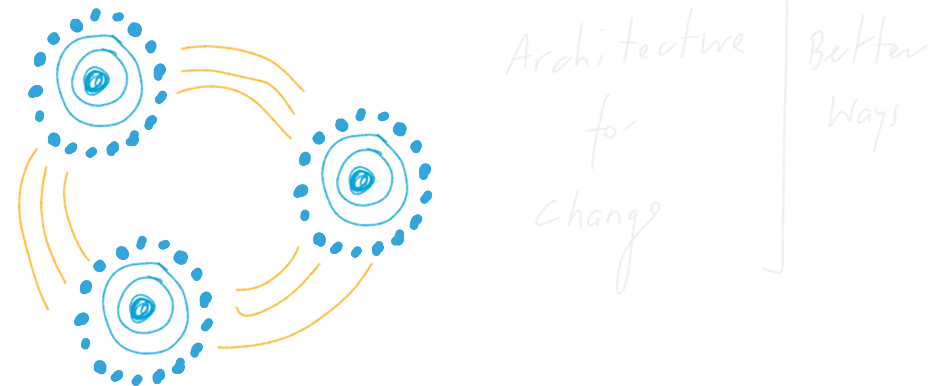

Slide 27
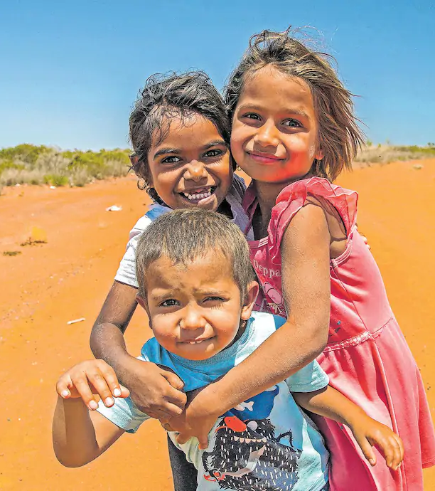
BHP to put $20 million into world-first research partnership with Telethon Kids Institute to help Aboriginal children in WA
Mining giant BHP is ploughing $20 million into a world-first research partnership with the Telethon Kids Institute to help Aboriginal children in WA.
The funding will be used over five years to work directly with 1000 Aboriginal families in Perth and the Pilbara to develop an unprecedented understanding of the issues facing indigenous children and improve their lives.
The $20 million investment, which is being announced tomorrow to coincide with the start of the 52nd Telethon weekend, is the second that BHP has made to child health research in WA.
Telethon Kids Institute director Jonathan Carapetis said the funding could lead to a “seismic shift” in working with Aboriginal communities.
“Never before at this scale has a research organisation partnered with Aboriginal families in such a comprehensive way,” he said.
“There will be genuine partnerships with Aboriginal researchers from those communities, training them up, working with families to understand in a holistic way what their needs are, what their challenges are as well as what their strengths are.”

Slide 28
Thank You

