Slide 1
Social media and Accessibility

Slide 2
Who knows who these two guys are?

Slide 3
What Hollywood would have you believe

Slide 4
What happens in reality
Notes:
How did I find this out? Social media

Slide 5
What is social media?

Slide 6
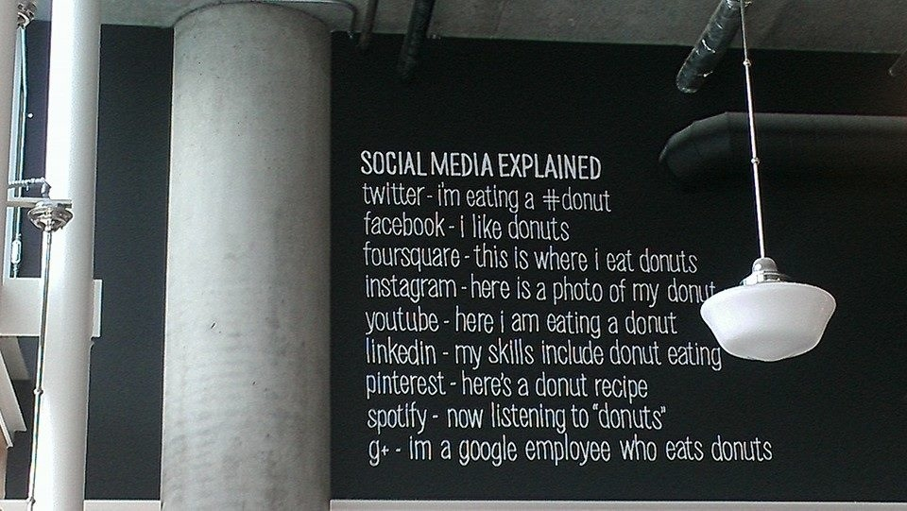
Social media explained

Slide 7
Social media according to a donut store

Slide 8
Why is social media so important for people with disabilities?

Slide 9
Some social media statistics
3.397 billion active social media users
On average people have 5.54 social media accounts
Average time spent on social media is 116 minutes per day
91% of retail brands use two or more social media channels
81% of all small / medium businesses use SoMe
Pew Research

Slide 10
Some social media statistics - teenagers
81% of teenagers felt more connected to their friends
69% believe it helps them interact with a more diverse group of people
68% feel as if they have people that will support them in tough times
Pew Research

Slide 11
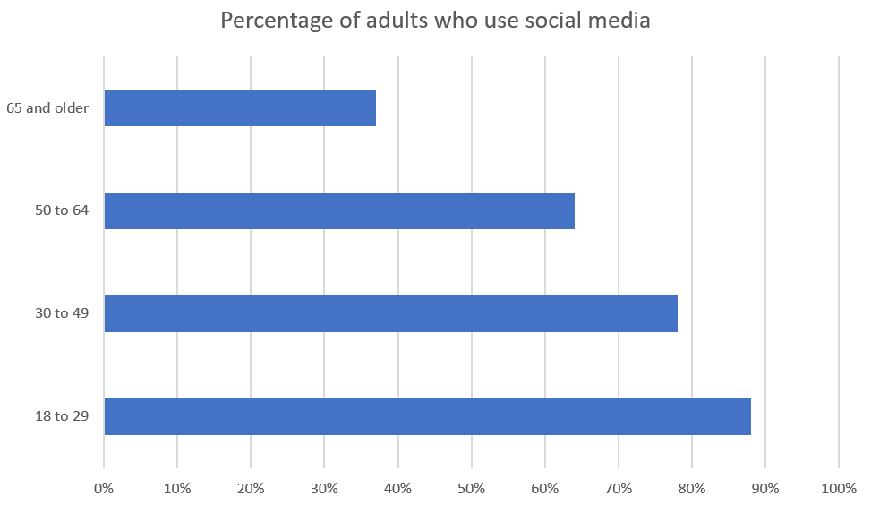
Percentage of each age group that use SoMe

Slide 12
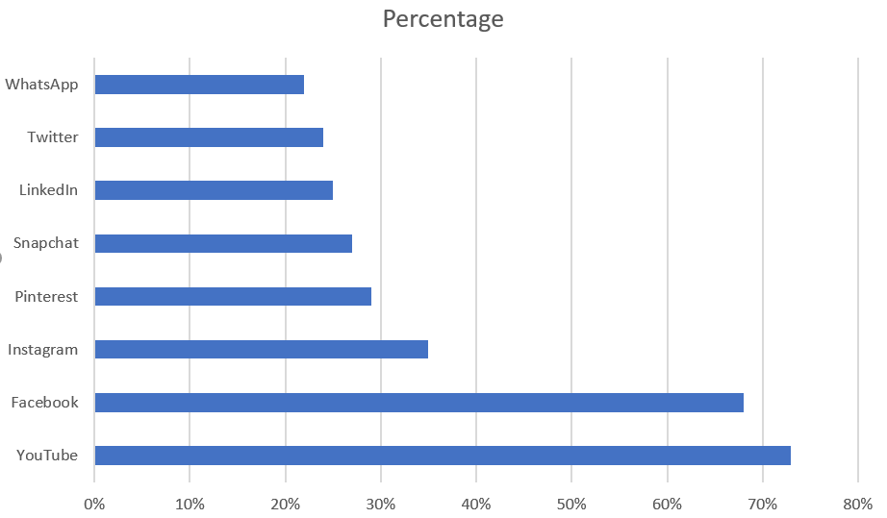
Percentage that use each SoMe

Slide 13
The importance of social media
Unemployment for people with disabilities is: 10.2%
The percentage of recruiters who use LinkedIn: 95%
The percentage of HR managers that have reconsidered hiring a candidate after looking at social media: 55%

Slide 14
The reasons behind social media use
Personal: examples include creating online commentary of personal thoughts, sharing photos and discussing social events.
Work: examples include creating a résumé, creating professional connections and discussing job opportunities.
Entertainment: examples include sharing videos, following discussion from celebrities, discussing strategies in online games.
Notes:
Personal – sharing photos about my travels
Work – keeping up-to-date with colleagues’ articles
Entertainment – meta on the latest SPN episode

Slide 15
The reasons behind social media use
Provision of goods and services: examples include sharing information about a product, responding to user feedback about a product, accessing government services.
Education: examples include participation in online classes and sharing learning resources
From Social media? Get serious!
Notes:
Provision of goods and services – Virgin Australia and Twitter
Education – how to fix my coffee machine

Slide 16
Why isn’t social media accessible?

Slide 17
Testing
#TestAllTheThings
Notes:
Facebook changes five times a day
Facebook releases changes internally then deploys

Slide 18
Keyboard trap (2018)

Slide 19
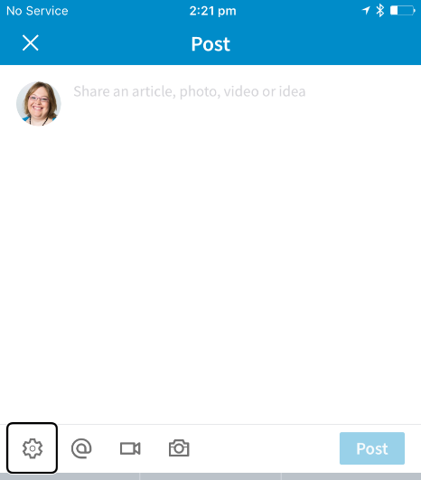
Button label
2017: Button unlabelled
2018: Button labelled as “button I p 20 4 d p button”
2019: Button replaced

Slide 20
What was tested?

Slide 21
What was tested?
A standard user journey:
Register
Log in
Read item
Submit item (and…)
User functionality:
Keyboard-only
Increase text size
Using a screen reader

Slide 22
Social media networks
2016, 2017, 2018:
Facebook
LinkedIn
YouTube
Twitter
2019:
Instagram
Pinterest

Slide 23
This is not a complete audit – there may be many other accessibility problems!

Slide 24
Common accessibility issues

Slide 25
Keyboard accessibility

Slide 26
Keyboard accessibility
 | Facebook | Instagram | LinkedIn | Pinterest | Twitter | YouTube
No keyboard trap | ü | ü | ü | û | ü | ü
Accessible to keyboard | ü | ü | ü | û | û | ü
Right hand column kb accessible | ü | û | û | NA | û | û
Keyboard focus indicator | ü | ü | ü | û | û | ü
Keyboard focus order | ü | û | ü | ü | ü | û
Notes:
Instagram
(KFI) Because of infinite scrolling never gets to the right hand column
(KFO): goes straight to photos, skips top header.
LinkedIn
Due to infinite scrolling never get to right hand column
Pinterest
Keyboard trap on explore
Share not keyboard accessible
KFI to select pin not there
Twitter
Due to infinite scrolling never get to right hand column
Video not keyboard accessible
KFI not visible on all elements
YouTube
Due to infinite scrolling never get to right hand column
KFO on video starts on play

Slide 27
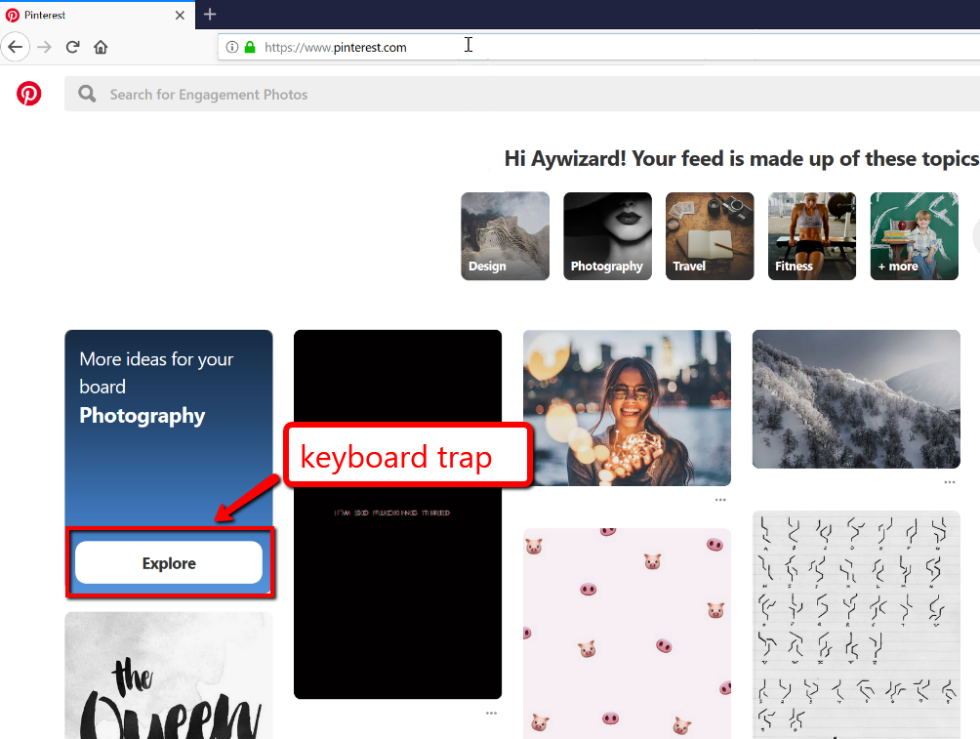
Pinterest – keyboard trap
û

Slide 28
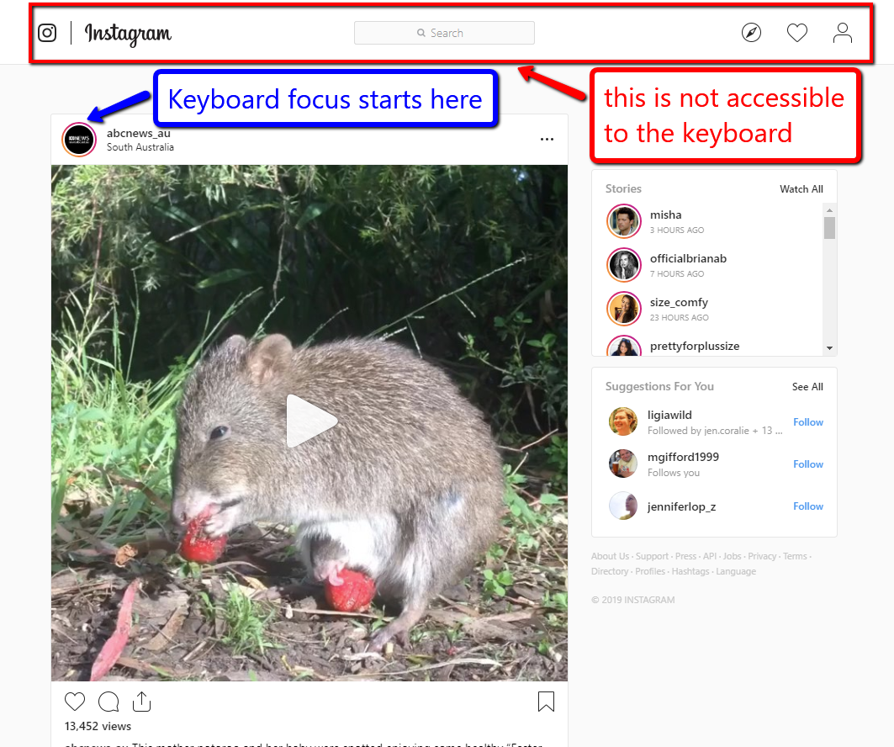
Instagram – keyboard focus order
û
û

Slide 29
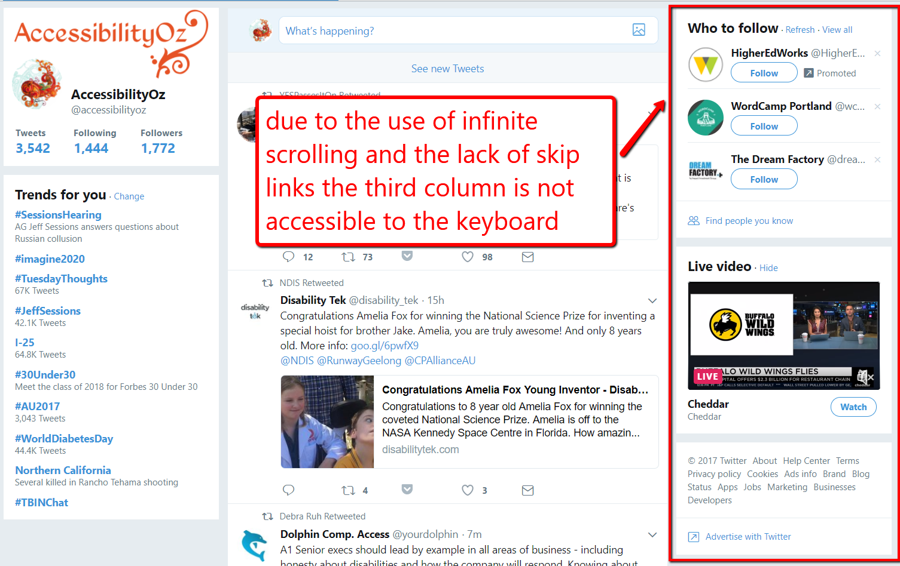
Twitter – right hand column not accessible to keyboard
û
û
û
û

Slide 30
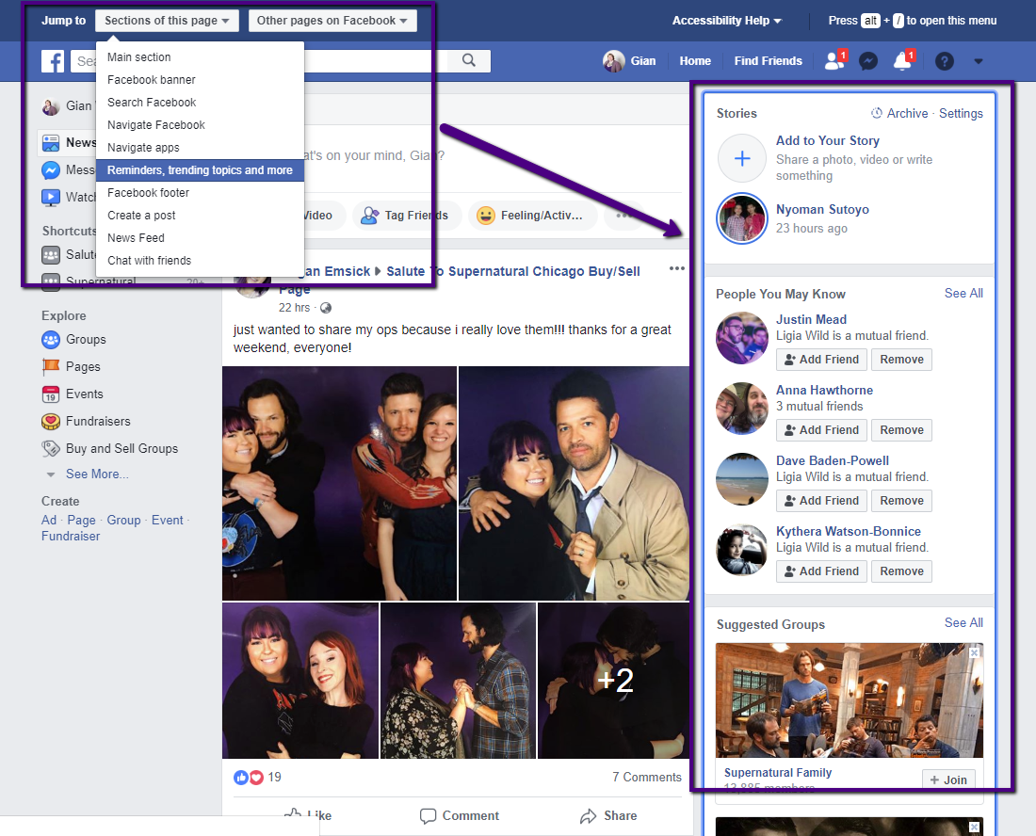
Facebook – numerous skip links
ü

Slide 31
Autoplay

Slide 32
Autoplay and keyboard accessibility
No autoplay on default viewing
Can the video be paused?
 | Facebook | Instagram | LinkedIn | Pinterest | Twitter | YouTube
Desktop | û | ü | û | û | û | û
iOS | û | û | û | û | û | û
 | Facebook | Instagram | LinkedIn | Pinterest | Twitter | YouTube
Mouse | ü | ü | ü | û | ü | ü
Keyboard | ü | ü | ü | û | û | ü
Touch - iOS | ü | û | ü | û | ü | ü
Notes:
Pinterest on desktop only autoplays when selecting a pin, but continues to autoplay and repeat that autoplay when returning to board

Slide 33
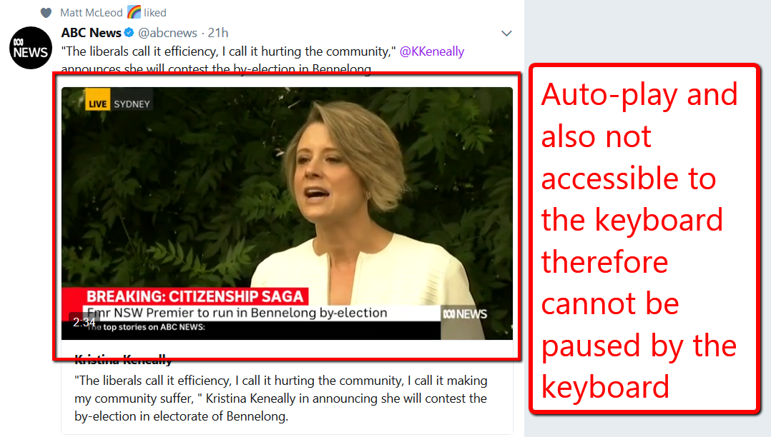
Auto-play and lack of keyboard accessibility
Violation of non-interference clauses in WCAG2 Level A 1.4.2: Audio Control and 2.2.2 Pause, Stop, Hide
û
û

Slide 34
Autoplay
Can turn off autoplay in settings
 | Facebook | Instagram | LinkedIn | Pinterest | Twitter | YouTube
Desktop | ü | NA | ü | û | ü | û
iOS | ü | û | ü | û | ü | û
Notes:
Pinterest – can turn off autoplay only on use of mobile data
YouTube – autoplay feature is not accessible and only refers to autoplaying of next video, not beginning video and plays two ads after the video before stopping

Slide 35
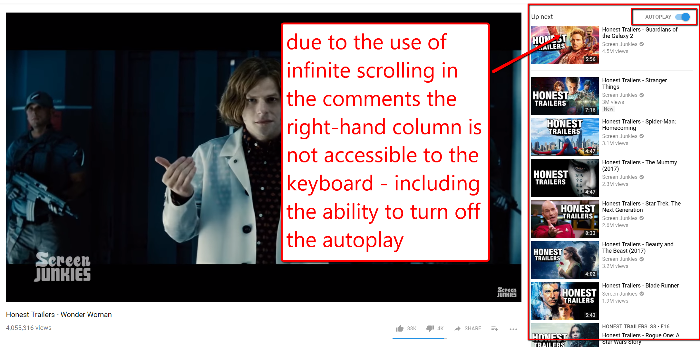
Autoplay - YouTube
û

Slide 36
Page titles and headings

Slide 37
Page titles
 | Facebook | Instagram | LinkedIn | Pinterest | Twitter | YouTube
Unique and descriptive page titles | ü | ü | û | û | ü | ü
Reference to the site | û | ü | ü | ü | ü | ü
Notes:
Facebook – all descriptive but profile page does not refer to facebook
Instagram – all descriptive as “Ellen on Instagram”
LinkedIn – all LinkedIn except login
Pinterest – all Pinterest
Twitter – all descriptive, but sometimes uses a slash, sometimes a dash
YouTube – all descriptive

Slide 38
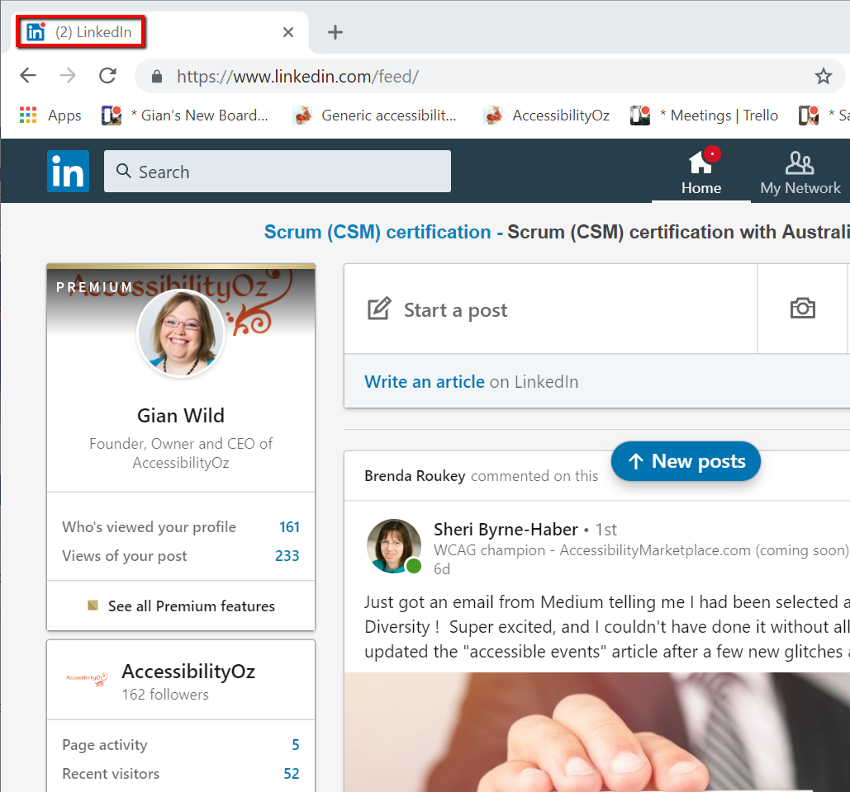
LinkedIn as page title on Home
û
û

Slide 39
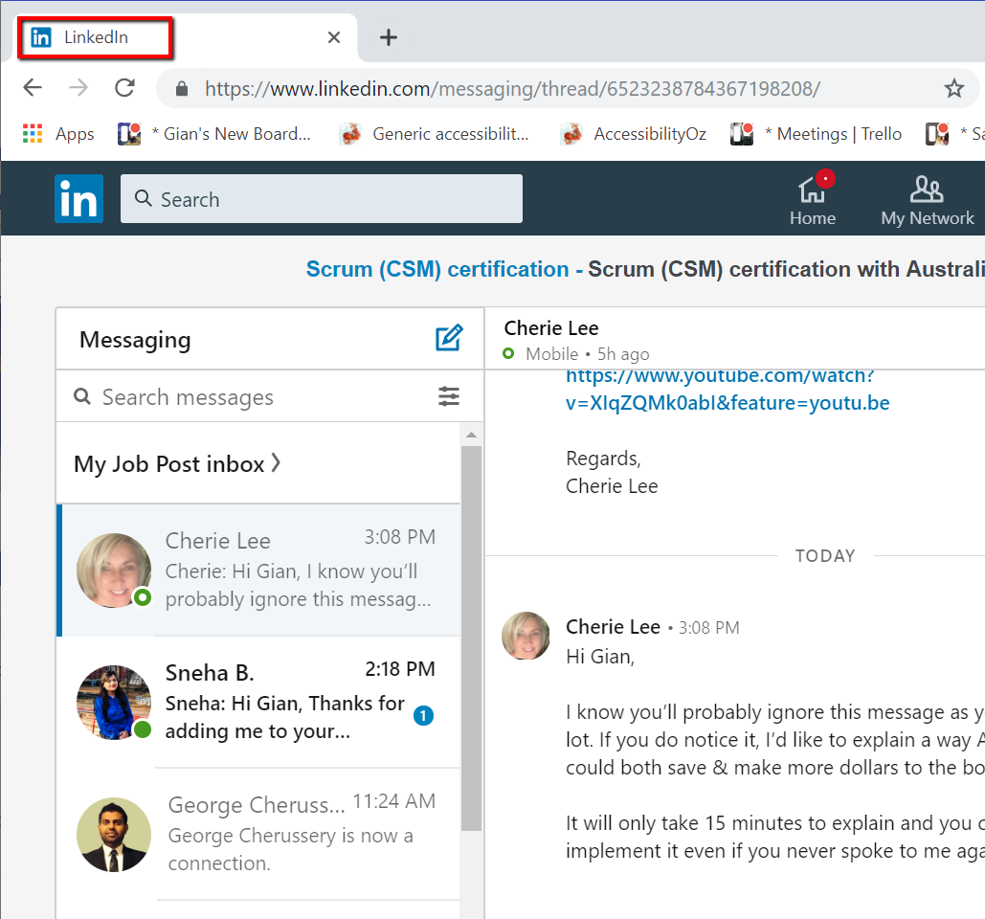
LinkedIn as page title on Messaging
û
û

Slide 40
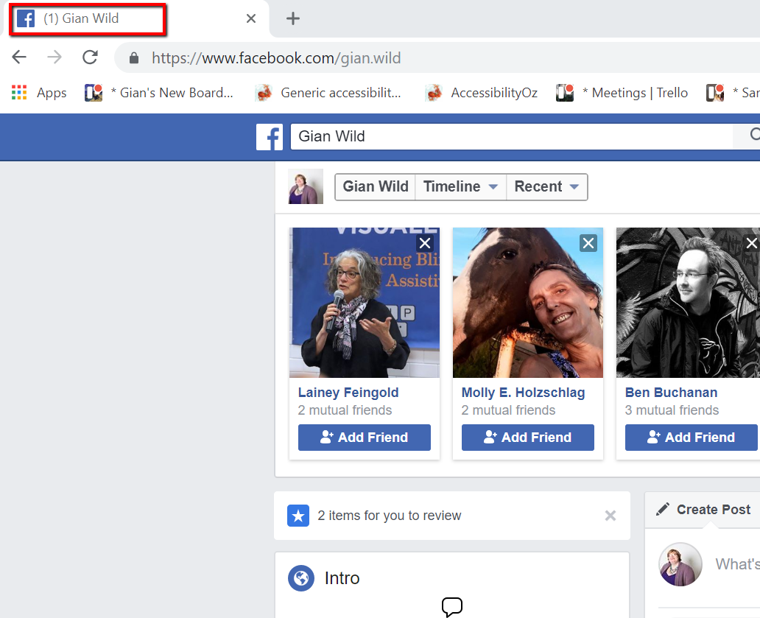
Facebook – page title has no reference to the site
û

Slide 41
Headings
 | Facebook | Instagram | LinkedIn | Pinterest | Twitter | YouTube
Properly nested headings | û | û | û | û | û | û
No content coded as a heading | ü | ü | û | û | û | û
All headings coded with H1, H2, H3 etc… | û | û | ü | û | û | ü
All pages start with H1 | ü | û | û | û | û | û
All pages have at least one appropriate heading | ü | ü | ü | û | ü | ü
Notes:
Facebook – headings coded as span role=“heading”

Slide 42
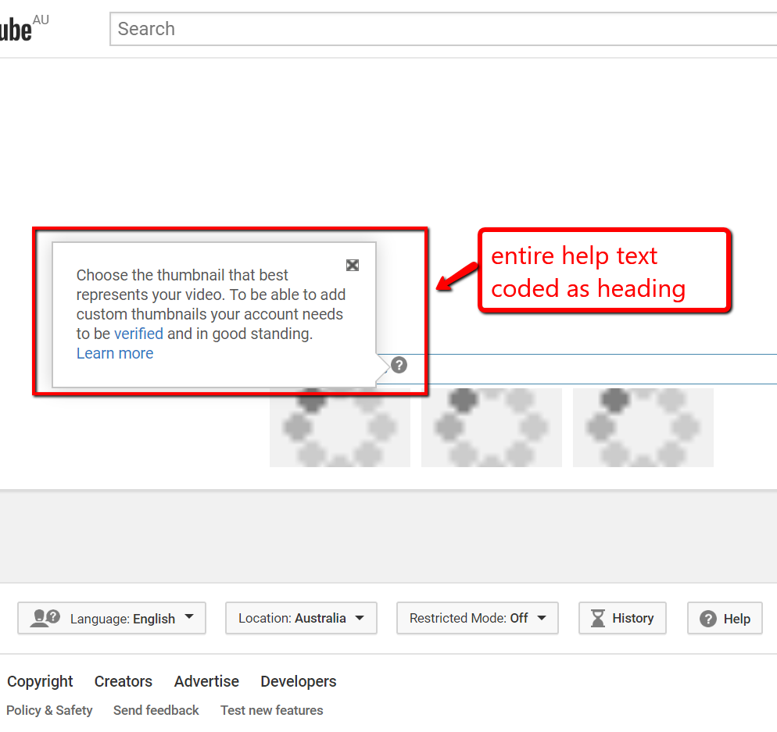
YouTube – content coded as a heading
û
û
û
û

Slide 43
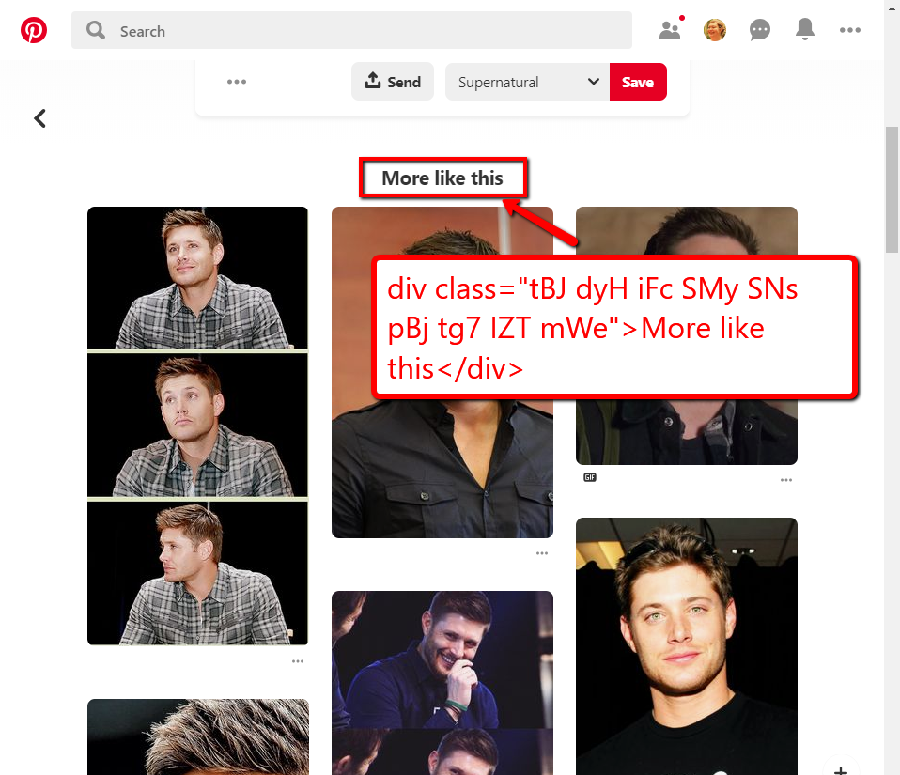
Pinterest – headings not coded with H1, H2, H3 etc
û
û
û
û
û

Slide 44
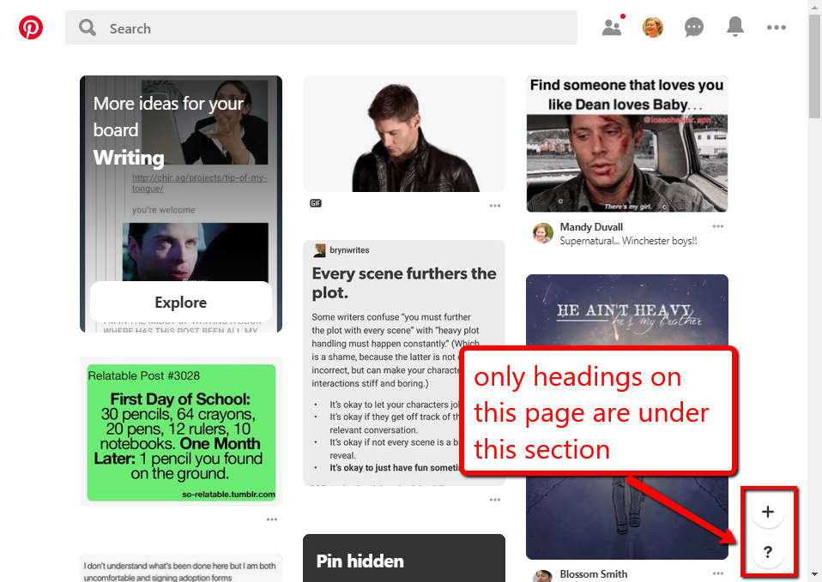
Pinterest – no headings
û

Slide 45
Inaccessible forms

Slide 46
Inaccessible forms
 | Facebook | Instagram | LinkedIn | Pinterest | Twitter | YouTube
Fields not coded with LABEL FOR and ID | û | û | û | û | û | û
FIELDSET missing a LEGEND | û | ü | ü | û | û | û
Orphaned or multiple field LABELs | ü | ü | û | û | ü | û
Radio buttons/ checkboxes do not have the same NAME | ü | ü | ü | ü | û | û

Slide 47
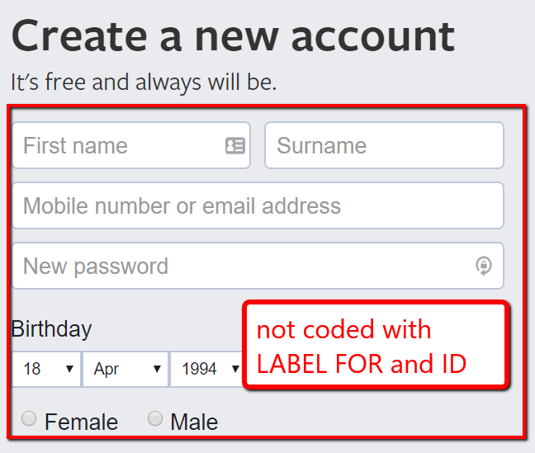
Facebook – fields not coded with LABEL FOR and ID
û
û
û
û
û
û

Slide 48
Incorrect use of ARIA and HTML

Slide 49
Incorrect use of ARIA and HTML
 | Facebook | Instagram | LinkedIn | Pinterest | Twitter | YouTube
Invalid ARIA | û | ü | û | ü | û | û
iFrame not accessible | û | û | û | û | û | û
JavaScript links | û | ü | ü | ü | ü | û
Empty links | û | û | ü | û | û | û
Missing mandatory attributes | û | ü | û | û | û | û

Slide 50
Screen reader

Slide 51
Desktop screen reader results
 | Facebook | Instagram | LinkedIn | Pinterest | Twitter | YouTube
Register | û | û | ! | ! | ! | !
Login | ! | ü | ü | ü | ü | ü
Create post with accessibility features | ! | ! | ! | û | ! | !
Read a post with accessibility features | ! | ü | ü | ü | ! | !
Notes:
Facebook
reCAPTCHA
Difficult to add ALT
Navigating using headings – infinite scrolling, sharing difficult
Instagram
All information is on same page but after Next button, “Sorry something went wrong”
Sometimes the “Next” button could not be accessed by VO
LinkedIn
Field labels are unclear
Hear remaining characters in ALT text after each letter
Pinterest
Edit name difficult, selecting topics difficult
Twitter
Verification difficult as is following someone
Alternative text add button difficult to find, must be turned on in settings, difficult to use tweet field
Lack of headings makes this difficult
YouTube
Phone number and DOB fields not accessible
Fields not labelled, can accidentally publish a video
No audio descriptions, no transcript

Slide 52
iOS screen reader results
 | Facebook | Instagram | LinkedIn | Pinterest | Twitter | YouTube
Register | ! | û | ü | û | ü | NA
Login | ü | - | ü | ü | ü | !
Create post with accessibility features | ! | - | ü | û | ü | !
Read a post with accessibility features | ü | - | ü | ü | ü | !
Notes:
Facebook
Birthday fields not accessible
Could not find a11y features
Instagram
“Sorry something went wrong”
LinkedIn
A11y features eg ALT not available
Pinterest
Could not select interests
Could not share pins
Twitter
Lack of headings
YouTube
Can only register with google account
Sign in element difficult
Unsure if actually uploading a video, unlabelled buttons
Audio descriptions and transcript

Slide 53
Five steps to making social media accessible

Slide 54
Step One: Contact details
Make your contact information available on your social media account page
List a primary phone number and email address where a user can reach your agency with questions, or provide a link to your agency website that lists the appropriate contact information

Slide 55
Step Two: Repeat content
Make your social media content available through your web site
Provide options for daily digests
Provide easy points of entry for more information
Post your social media to multiple outlets

Slide 56
Step Three: Provide alternative apps
Provide contact details to social media support /accessibility teams within your organisation
Provide links to the social media accessibility tips and support
Provide links to alternative apps and web sites that create an accessible interface for social media

Slide 57
Step Four: Clear and simple language
Use camel case, for example:#CodeMotionRome
Avoid abbreviations
Limit hashtags and add them only to the end
Avoid miss-spellings
Where linking to others’ content on YouTube, warn users of auto-play, lack of transcripts, captions or audio descriptions

Slide 58
Step Five: Test
Consider testing your social media with users with disabilities
Consider testing your social media against WCAG2
Adapted from digital.gov

Slide 59
Questions? Pz.tt/some19-ahg

