Slide 1
What does peanut butter have to do with accessibility?
Presented by Gisele Mesnage
Founder – Digital Gap Initiative
Notes:
My talk today is titled: “What does peanut butter have to do with accessibility?”
In 2014 I lodged a Disability Discrimination Act (DDA) complaint in the federal circuit court against Coles Supermarket, because I could not complete an order on their online shopping website.
I was represented by the Public Interest Advocacy Centre (PIAC)
Under the guidelines to the DDA on web accessibility, published on the Australian Human Rights commission website, it said that commercial websites were required to comply to the WCAG 2.0.
So, I told my lawyers, “hey , we don’t need to go to court. Look, it’s right here: Coles has to do this”
But the lawyers said that a requirement in the ‘guidelines to the DDA’ was not the same as a requirement in the Act (the DDA).

Slide 2
Why is it so?
Notes:
I asked one of the young lawyers working on my case, Leah Grolman, “Why is it so?”
“Why does the DDA apply to access ramps in buildings, but not apply to website accessibility?”

Slide 3
“Hard laws” = mandatory
Notes:
Leah explained that access ramps were part of the ‘Access to premises’ standard, which had been passed into ‘hard law’.
‘Hard laws’, she explained, were mandatory.

Slide 4
“Soft laws” = voluntary
Notes:
Leah then explained that guidelines, principles, the UN Convention on the rights of people with disability and other such protocols were ‘soft laws’.
Soft laws, she explained, were voluntary.
The guidelines to the DDA was an example of a ’soft law’.
The WCAG was another example of a ‘soft law’.
As I tried to make sense of that explanation, it made me think of peanut butter.

Slide 5
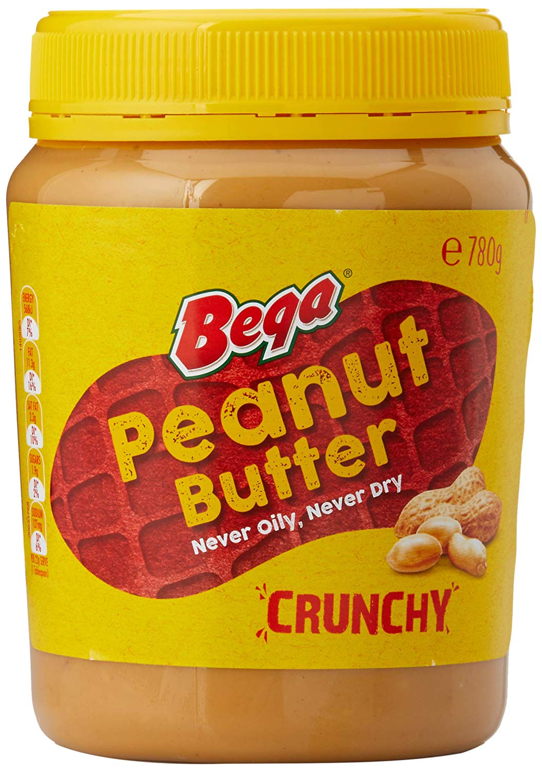
“Hard laws” = Crunchy Peanut Butter
Notes:
I thought of ‘hard laws’ being like crunchy peanut butter.

Slide 6
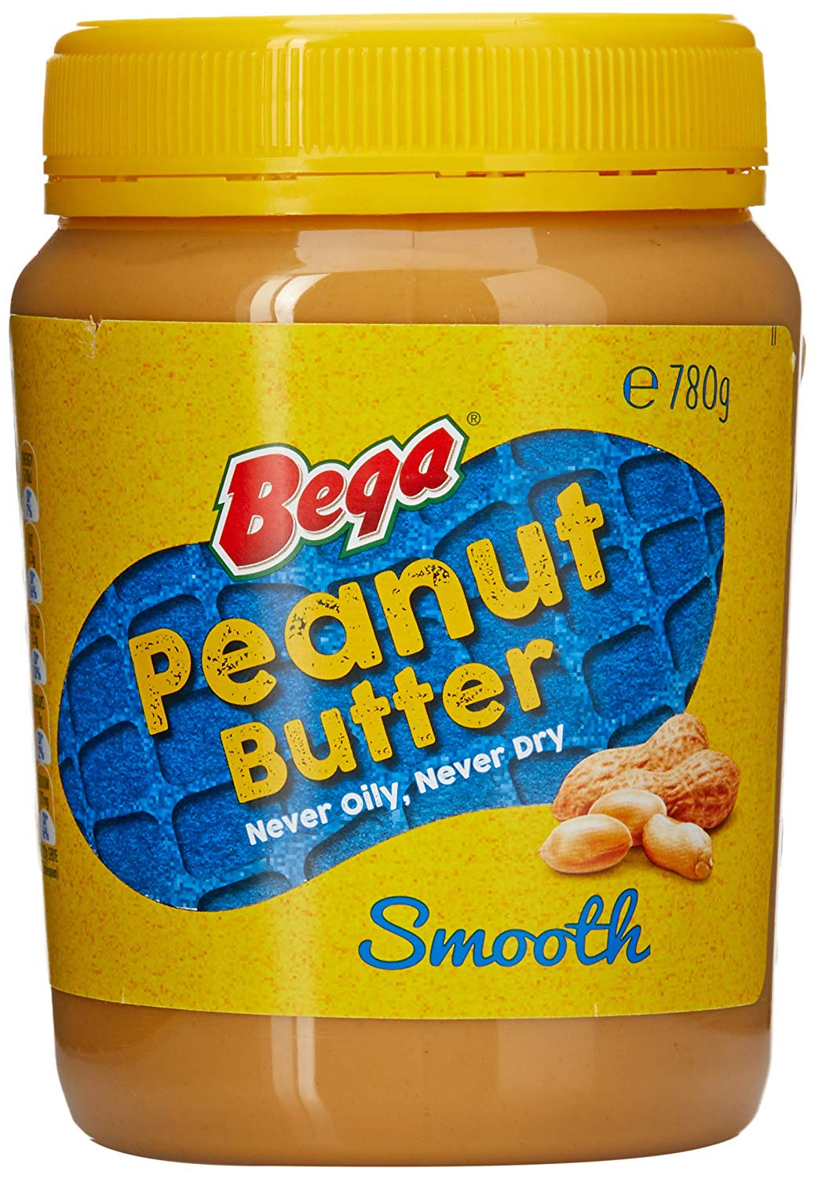
“Soft laws” = Smooth Peanut Butter
Notes:
And ‘soft laws’ being like smooth peanut butter.
Then it made sense…

Slide 7
“Peanuty” Law
Notes:
In fact, Lea recently wrote to me from the UK, where she is now working as a solicitor: It appears that the peanut butter definition is now officially recognised in law dictionaries.
The legal terminology is ‘peanuty law’.
That’s P-E-A-N-U-T-y law.

Slide 8
Digital Gap Initiative
Legal reforms, standards and strategies towards digital accessibility
Accessibility makes good business sense
Coding for accessibility
Notes:
Once I understood this ‘peanuty’ soft and hard law divide, I felt it was imperative that something be done to advocate for law reforms in this area.
And so, on 7 December 2014, on a stormy Sunday, while drinking a cup of Rooibos tea, I founded the Digital Gap Initiative.
DGI advocates for legal reforms, standards and strategies for digital accessibility, promotes the business case for accessibility, and coding for accessibility.
My father was an electronics engineer, who also built a robotic arm.
And he explained to me that if he wanted his robotic arm to do this, he programmed it to do this.
“It’s all about coding”, he said: “Accessibility is possible”.
And to quote Mr Spock “Accessibility is logical”.

Slide 9
“Crunchier” accessibility laws
Notes:
So, it’s simple: DGI is advocating for crunchier accessibility laws.
That is, for digital accessibility to be passed into hard law.

Slide 10
Access Award for Corporate Website of the year!
Notes:
I started this talk by talking about my legal action against Coles Online.
But now I want to mention the fantastic work Coles has been doing around the accessibility of all their digital services.
When the Centre for Accessibility announced last year that it was launching its inaugural ‘Access Awards’, I had no hesitation in nominating the Coles Online website for an award.
And I was over the moon when Coles won the access award for Commercial Website of the Year.
Thank you, Coles, and congratulations.

Slide 11
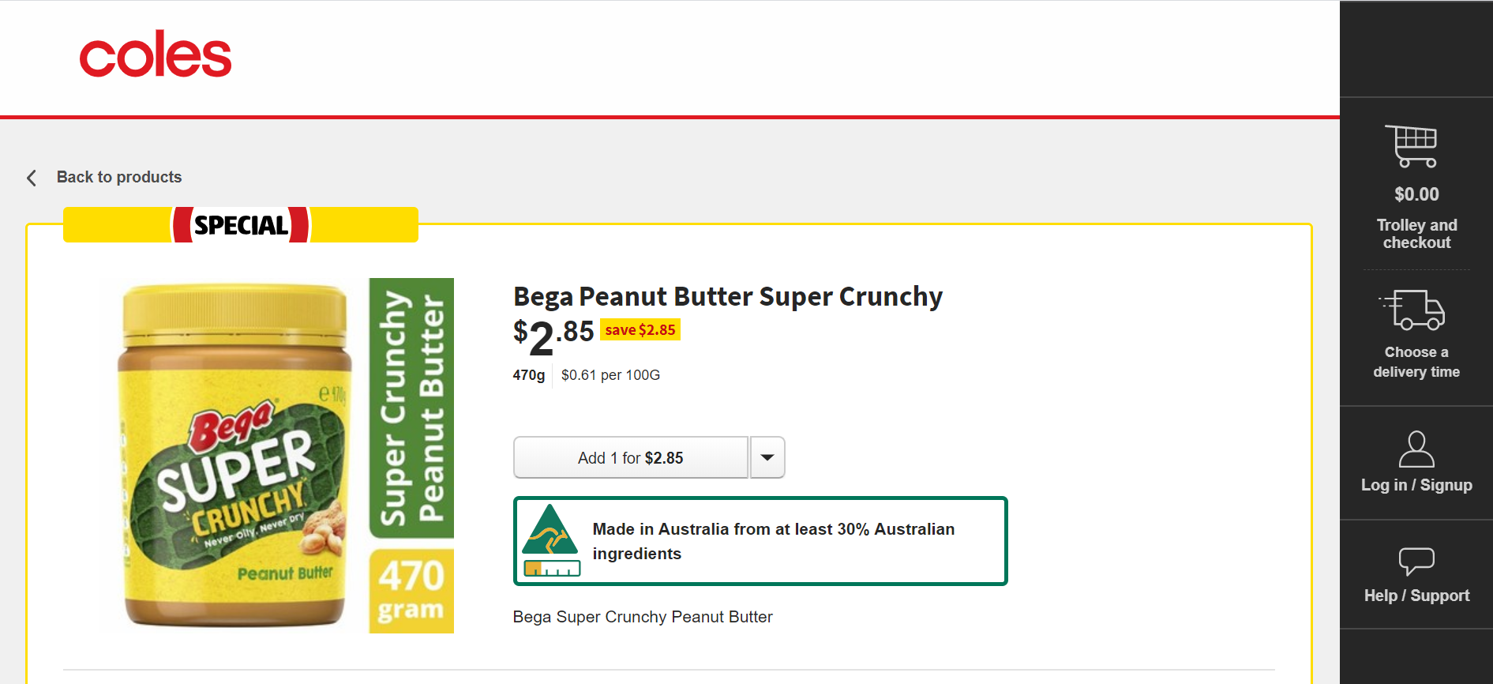
Get your Super Crunchy Peanut Butter online at Coles!
Notes:
Now, I can easily do my online shopping on the Coles website and find all the specials.
And due to this, during my last online shopping a few days ago, I learned that ‘super crunchy’ peanut butter was now available.
This prompted me to rethink DGI’s main demand: we don’t just want crunchier accessibility laws. We want super crunchy accessibility laws!
And so now you know what peanut butter has to do with accessibility!

Slide 12
Digital Gap Initiative
www.digitalgap.org
Notes:
Closing notes:
Explain how much I wanted to come to this session on laws and standards and policies.
Please visit DGI’s new website at www.digitalgap.org.
Thank you to AccesibilityOz for our new website that was created pro bono by AccessibilityOz. And congratulations here to Gian Wild from AccessibilityOz for her Access Award win too!
Thank you Lizzie Pickering for creating this presentation.
Thank the organisers and the sponsors for making it possible for me to attend the conference.
Give away the jars of peanut butter.

