Slide 1
OZeWAI - Accessibility in an agile environment
Senior Digital Accessibility Consultant
christos.petrou@cfid.org.au
Notes:
Often accessibility is an add on at the end of the development process.
So how do we make accessibility normal practice in an agile environment? In this presentation I will take you to a journey looks at some of the different options and pathways to baking in accessibility in a development environment including automation, dashboards, and change management.

Slide 2
Acknowledgment
I like to acknowledge the
Traditional custodians of country throughout Australia
and recognise their continuing connection to land water and culture.
I also like to acknowledge
The Noongar people
the Traditional Custodians of the land we meet today
and pay our respects to their Elders past present and future.
I also like to acknowledge the
Aboriginal and Torres Strait Islander people present.

Slide 3
What is Agile
agile /ˈadʒʌɪl/ /ˈ Adjective Able to move quickly and easily.
Agile software development comprises various approaches to software development under which requirements and solutions evolve through the collaborative effort of self-organizing and cross-functional teams and their customer(s)/end user(s).^{[1]} It advocates adaptive planning, evolutionary development, early delivery, and continual improvement, and it encourages rapid and flexible response to change.
Notes:
What this mean is that we usually have 2 to 4 weeks sprints that new features are develop and deliver for clients to use.

Slide 4
What is Accessibility
accessibility /əksɛsɪˈbɪlɪti/ noun
The quality of being easy to obtain or use.
Notes:
My definition of Accessibility for a software is the quality of been easy to obtain or use. WCAG is the tool that helps achieve this by providing guidance on possible way on how to go about creating accessible digital solutions.

Slide 5
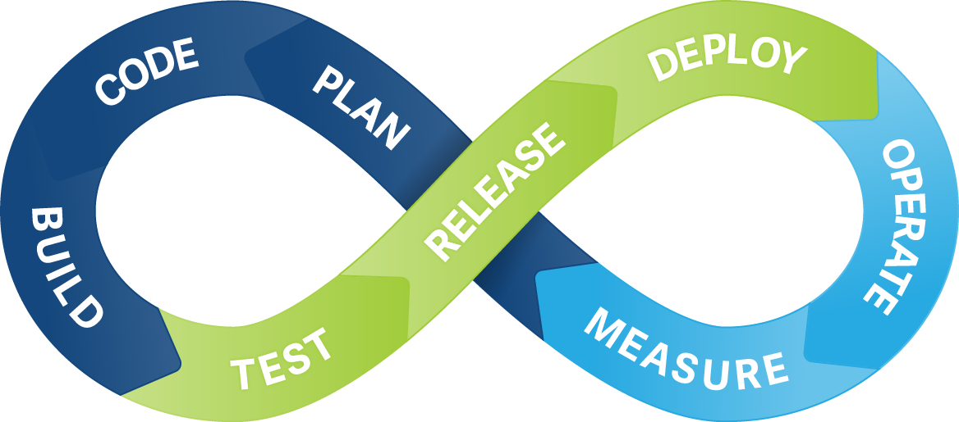
Why Agile needs Accessibility
Each feature is complete in a sprint.
If accessibility is not included then the feature is not considered as completed (Done).
Notes:
In an agile software development process for a feature to be evaluated as Done all work much be completed. If accessibility it not done during the sprint then the feature is not Done.

Slide 6
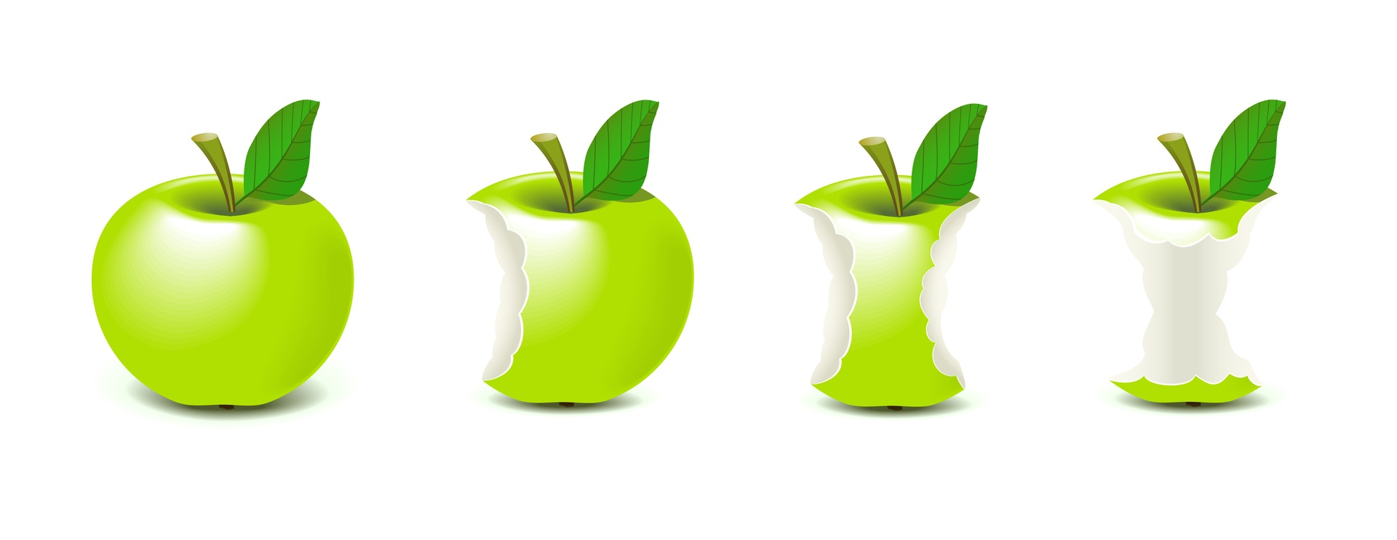
Bite-size chunks
WCAG is big and boring.
How can you change a11y testing to fit in an agile software development environment?
WCAG is big and boring.
How can you change a11y and stream line testing in an Agile environment?

Slide 7
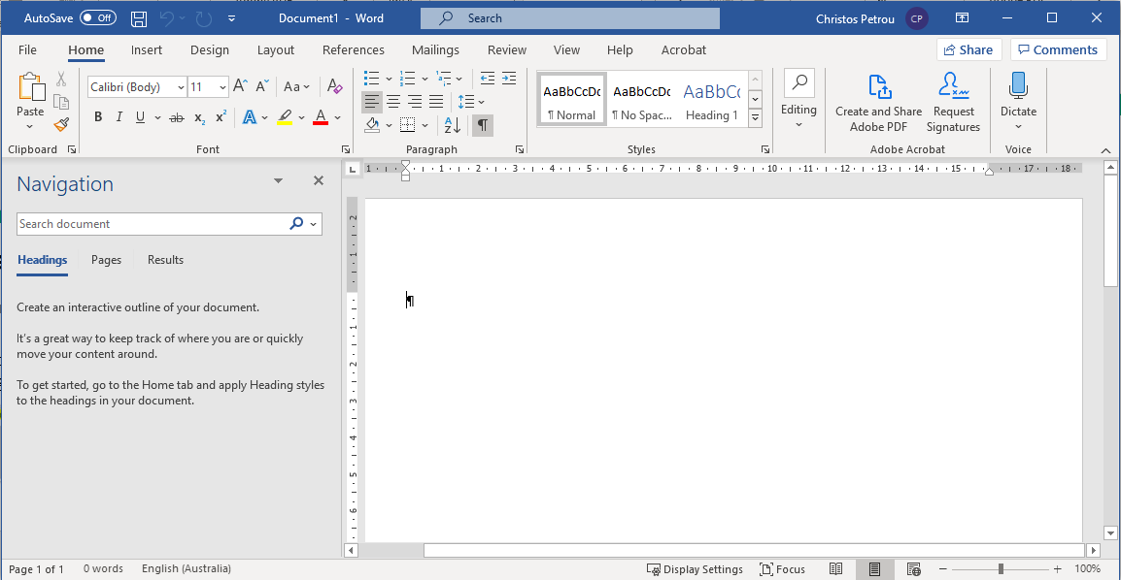
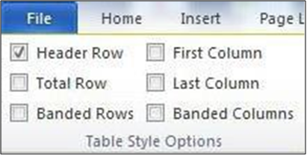
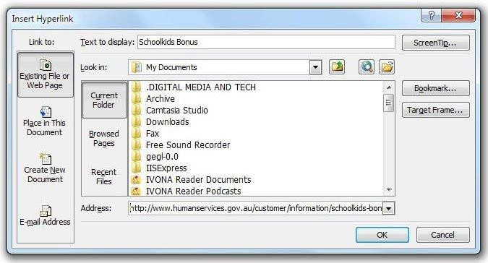
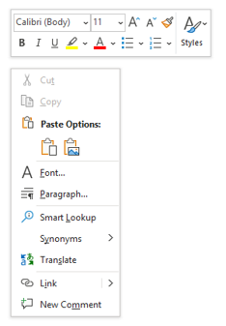
Analyse your product
Identify areas of your product in screen areas (Windows, Templates, dialogs, menus, pickers etc...).
Structure your test to fit your product (AVT1, AVT 2 ….).

Slide 8
Accessibility Verification Tests (AVT)
AVT 1: Accessibility Tools Testing (Dev).
e.g. OzArt, Monsido, SortSite, SiteImprove, Axe plugin, DAP plugin
AVT 2: Keyboard Navigation (Functionality), Visual Focus, Colour Contrast (Dev and Test).
AVT 3: Screen on Desktop and Laptop (Test).
AVT 4: Screen Readers and Responsive design on mobiles and Tablets (Test).
AVT 5: Automation (Dev, Test, Automation Team).

Slide 9
Existing and New Features
Focus on existing features.
Identify patterns to help improve new features.
Develop test that will test elements of your product (e.g. buttons, menus, custom elements).
Use findings to improve new features development.

Slide 10
Automation and CI
Unit Testing – Very Fast.
- on element level (buttons, custom elements, accordion, video player, date/time pickers).
End to End (e2e) Much slower.
- Design test check a11y not FVT.

Slide 11
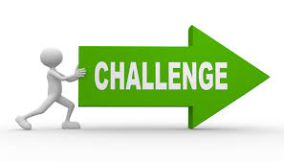
Challenges
WCAG fear
Up Skilling (On accessibility and how to include a11y in Unit Test and e2e automation).
Building the automation framework (Reliable Page Objects, stable automation tests).
Adding Accessibility Automation on CI.
Technology is fast paced (Developers are overwhelmed).
Notes:
.

Slide 12
Benefits
Establish internal Benchmark.
A11y automation in CI capture regressions.
Repetitive test, run on every build on million lines of code
AVT is part of FTV (Functional Verification Test).
Encourage cleaner code.
Better code structure = Improved code.
Helps to benchmark your product.
Better Faster and more efficient code.
A more maintainable code utilising the free browser support features.

Slide 13
Questions?
Senior Digital Accessibility Consultant
christos.petrou@cfid.org.au

